Slide 1
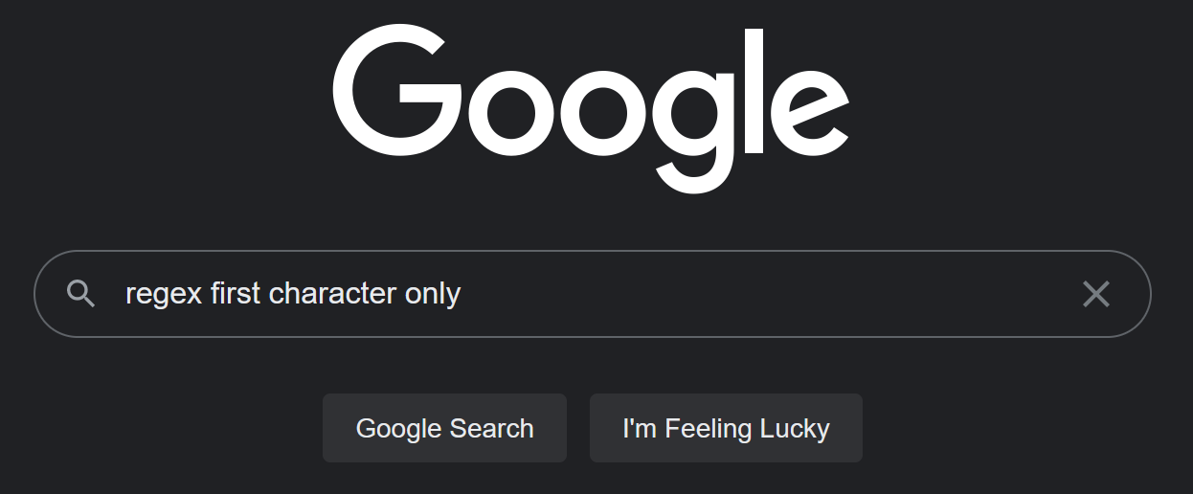
Day 1 of Programming
10 Years of Programming

